Slide 1



ONEVOTE
Presentation by Asif Kamal, Amar Biradar, Gaurav Kumar Singh, Saurabh Kumar Singh
"OneVote – Voting Reinvented with Trust and Tech."

Slide 2

INTRODUCTION
OneVote is a blockchain-based digital voting system designed to ensure transparent, secure, and tamper-proof elections.
It aims to eliminate fraud and double voting through distributed ledger technology and smart contract enforcement.
The platform ensures voter anonymity while making every transaction verifiable and auditable.
Smart contracts automate election rules, reducing manual errors and bias.
Aligned with UN SDG 16, OneVote promotes peace, justice, and strong institutions through trustworthy digital governance.
"OneVote – Voting Reinvented with Trust and Tech."

Slide 3

WHY ONEVOTE?
Prevents Election Fraud
Each vote is cryptographically sealed and cannot be changed.
Enables Remote Participation
People can vote from anywhere—home, hospital, abroad.
Real-Time Tracking & Instant Results
No waiting days for manual counts—results are updated instantly.
Increases efficiency and reduces human error.
Restores Trust in Democracy
Anyone can verify the vote count, increasing public trust.
Citizens regain confidence in the voting process.
"OneVote – Voting Reinvented with Trust and Tech."

Slide 4
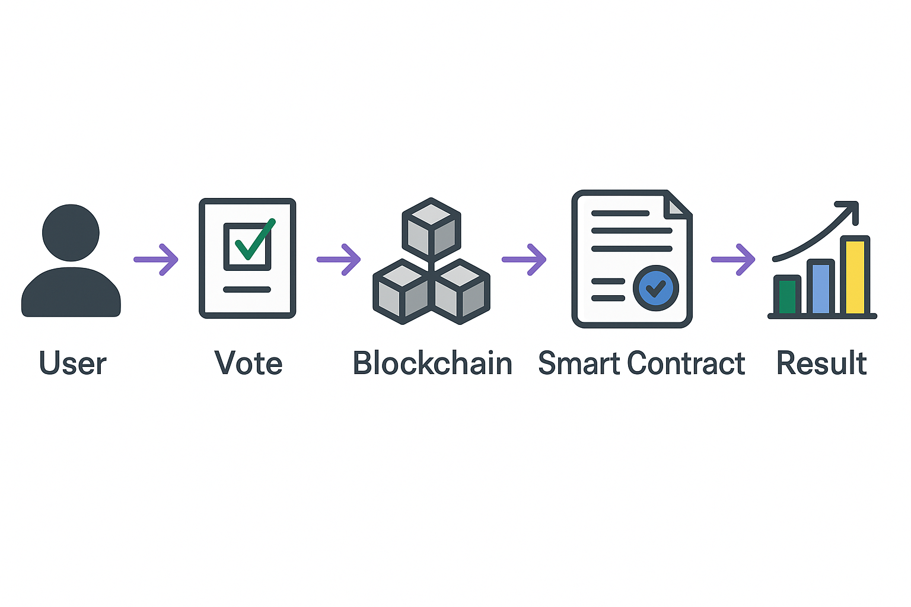
IMPLEMENTATION
"OneVote – Voting Reinvented with Trust and Tech."

Slide 5
KEY FEATURES OF OneVote
Transparency
Every vote and transaction is recorded on the blockchain and visible to authorized participants, ensuring full transparency throughout the election process.
Distributed Architecture
The system operates on a decentralized network, reducing the risk of single points of failure and making the voting process more secure and resilient.
Auditable Transactions
All voting transactions are permanently recorded and tamper-proof, allowing for independent audits and verification of results at any time.
Smart Contract Execution
Voting rules and processes are encoded into smart contracts, ensuring automatic, consistent, and fair execution without human intervention or manipulation.
"OneVote – Voting Reinvented with Trust and Tech."

Slide 6
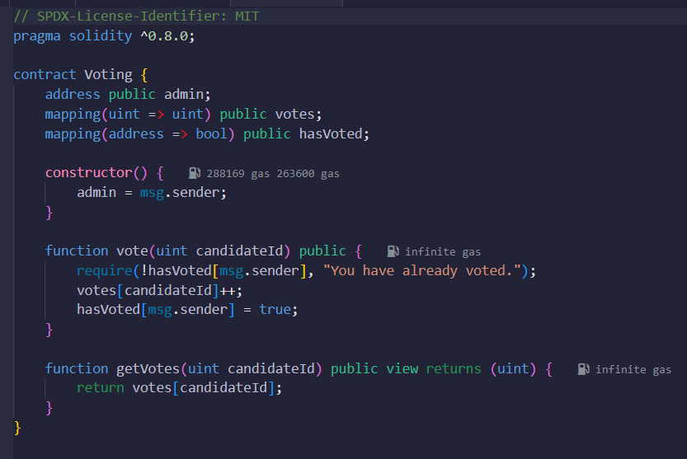
SMART CONTRACT
"OneVote – Voting Reinvented with Trust and Tech."

Slide 7
CONCLUSION
OneVote ensures that each vote cannot be tampered with, building trust in the voting process.
Whether at home or abroad, anyone can vote securely, empowering more people to participate in elections.
Real-time results and instant verification eliminate delays and mistakes, making elections quicker and more reliable.
By leveraging blockchain and smart contracts, OneVote revolutionizes voting—making it secure, transparent, and accessible for everyone.
"OneVote – Voting Reinvented with Trust and Tech."

Slide 8
THANK YOU
Presentation by Asif Kamal, Amar Biradar, Gaurav Kumar Singh, Saurabh Kumar Singh
"OneVote – Voting Reinvented with Trust and Tech."

